Slide 1
Advanced BGP Ruting and IXP
ISPAB Workshop
Version 0.1

Slide 2
Advanced BGP Routing and IXP
ISPAB Workshop

Slide 3
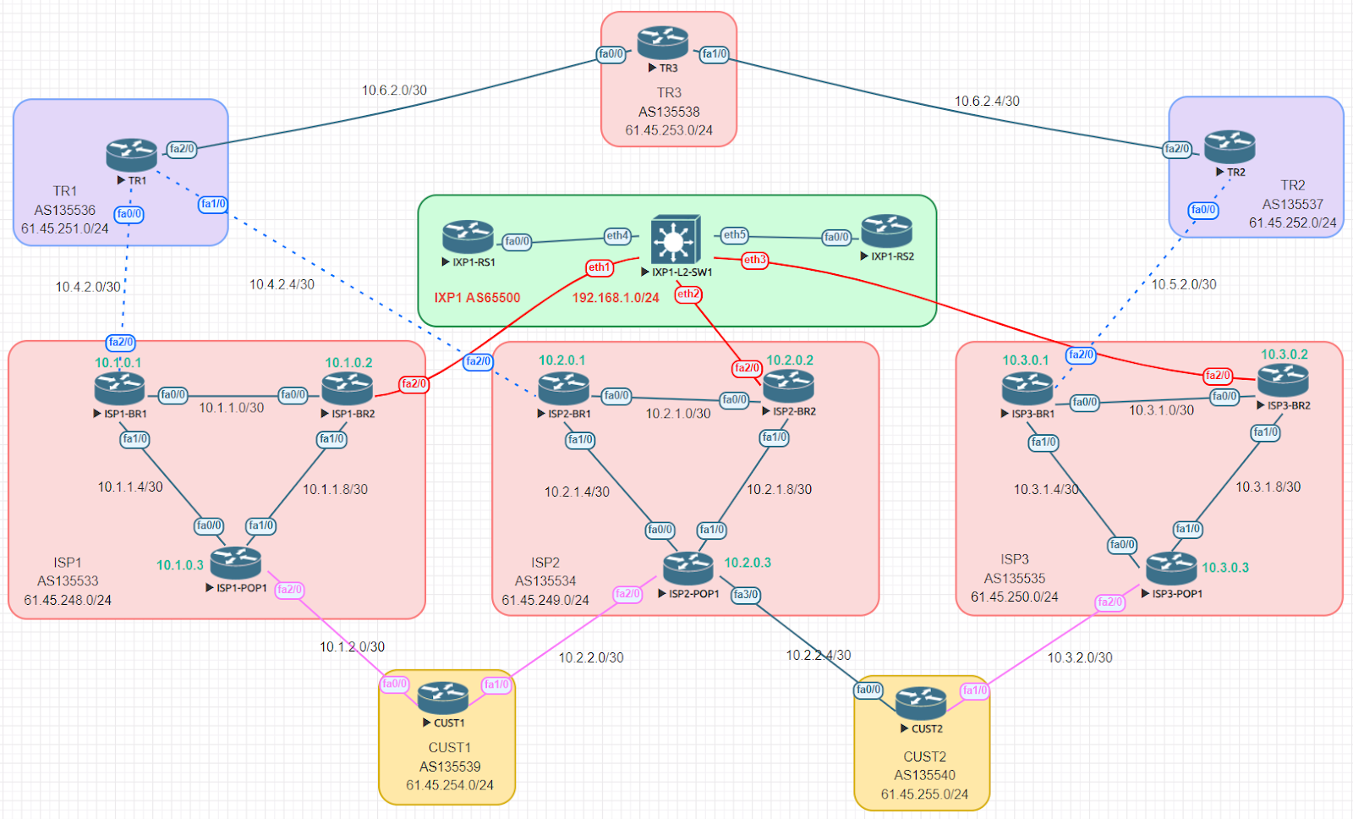
Lab Topology

Slide 4
IP Plan
Provider | ASN | Private IP |  |  | Public IP
ISP1 | 135533 | 10.1.0.0/22 | Loopback | 10.4.0.0/24 | 61.45.248.0/24
 |  |  | Infra P2P | 10.4.1.0/24
 |  |  | PE-CE | 10.4.2.0/24
ISP2 | 135534 | 10.2.0.0/22 | Loopback Infra P2P PE-CE | 10.5.0.0/24 10.5.1.0/24 10.5.2.0/24 | 61.45.249.0/24
ISP3 | 135535 | 10.3.0.0/22 | Loopback Infra P2P PE-CE | 10.6.0.0/24 10.6.1.0/24 10.6.2.0/24 | 61.45.250.0/24
TR1 | 135536 | 10.4.0.0/22 | Loopback Infra P2P PE-CE | 10.1.0.0/24 10.1.1.0/24 10.1.2.0/24 | 61.45.251.0/24
TR2 | 135537 | 10.5.0.0/22 | Loopback Infra P2P PE-CE | 10.2.0.0/24 10.2.1.0/24 10.2.2.0/24 | 61.45.252.0/24
TR3 | 135538 | 10.6.0.0/22 | Loopback Infra P2P PE-CE | 10.3.0.0/24 10.3.1.0/24 10.3.2.0/24 | 61.45.253.0/24
CUST1 | 135539 | 10.7.0.0/22 | Loopback Infra P2P PE-CE | 10.7.0.0/24 10.7.1.0/24 10.7.2.0/24 | 61.45.254.0/24
CUST2 | 135540 | 10.8.0.0/22 | Loopback Infra P2P PE-CE | 10.8.0.0/24 10.8.1.0/24 10.8.2.0/24 | 61.45.255.0/24
IXP1 | 65500 | 192.168.0.0/22 | IXP-LAN IXP-MGMT | 192.168.1.0/24 192.168.2.0/24

Slide 5
Lab Objectives
Task-1: Configure IP address of all router (Pre-configured)
Task-2: Configure Routing Protocol (for ISP core)
Configure OSPF as IGP
Configure iBGP (BR1 is RR)
Task-3: Configure eBGP between TRs
Configure eBGP between TRs; Announce public IP block
Task-4: Configure eBGP between ISPs and TRs
Configure eBGP between ISPs and TRs; Announce public IP block
Configure inbound prefix filter at TRs
Task-5: Configure eBGP between ISPs and Customers
Configure eBGP between ISPs and Customers; Announce public IP block
Configure inbound filter at ISPs; outbound filter at Customers; update inbound filter at TRs
Task-6: Configure IXP1 Route Servers (Pre-configured)
Task-7: Configure TE with BGP LP and Community attribute
Configure Local Preference value: Customer > IXP > TR
Configure BGP community to prevent IX route leaking

Slide 6
Thank you !!

